Slide 1


Noida institute of Engineering & Technology
Department of CSE (AI)
Session (2024-25)
PDA Project (ACSAI0617) Presentation on
“BUILDING A SMART MOVIE RECOMMENDATION SYSTEM
WITH MACHINE LEARNING”
Submitted To: Group Member:
Ms. Garima Jain Utkarsh Sahu (2201331520199)
Asst. Prof. CSE(AI) Pratiksha Maurya(2201331520132)
Tanishka Bhardwaj(2201331520190)
Tanvi Srivastava(2201331520192)

Slide 2
Presentation Outline
Introduction
Literature Review
Research Gap
How to overcome Research Gap
Objectives of the Research work
Methodology
Result
Conclusion
References

Slide 3
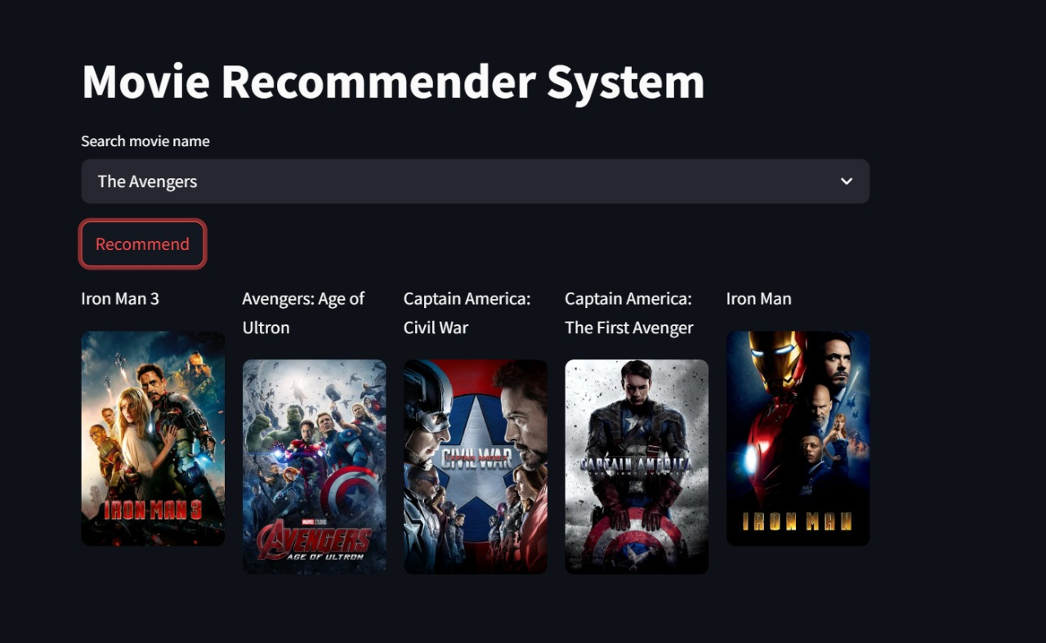
Introduction
Rise of Streaming & The Need for Recommendations
Streaming platforms (Netflix, Amazon Prime, Disney+) offer vast libraries.
Viewers face “choice paralysis” due to content overload.
Global video streaming market projected to reach USD 223.98 billion by 2028.
Intelligent recommendation systems improve user engagement and retention
.

Slide 4
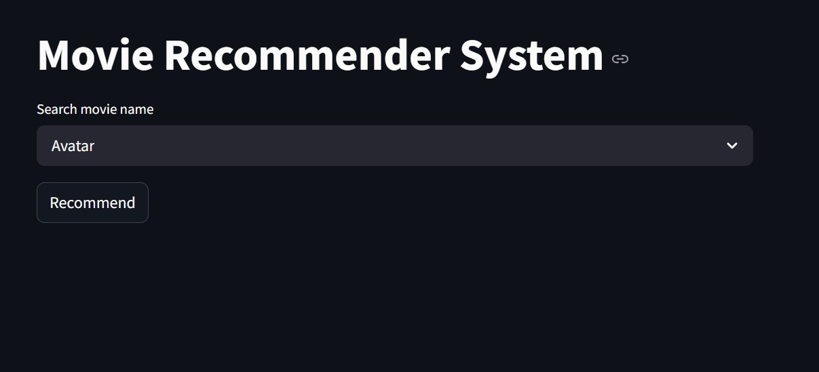
Introduction
Why Content-Based Filtering?
Uses movie metadata (genres, cast, director, etc.) for recommendations.
Advantages:
✅ Cold-start resilience
✅ Transparent reasoning (explainable recommendations)
Our system suggests similar movies based on selected movie features using cosine similarity on TF-IDF vectors.
.

Slide 5
Literature Review
Summary of Prior Work on Recommender Systems
Collaborative Filtering
Learns from user behavior; suffers in cold-start situations.
Content-Based Filtering
Based on movie features; works with sparse user data.
Hybrid Models
Combine methods for higher accuracy (Burke, 2002).
.

Slide 6
Research Gap
Current Limitations in Recommendation Systems
Collaborative filtering fails in cold-start and sparsity conditions.
Many models lack transparency—users don't understand "why" suggestions are made.
Deep learning models are often computationally heavy and require large datasets.
.

Slide 7
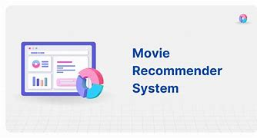
Research Gap
Need for Lightweight, Explainable Systems
Most academic/industry systems are not optimized for deployment on modest hardware.
Lack of demo-ready, dockerized applications for rapid prototyping.
Our project bridges these gaps with a lightweight, modular, content-based system.

Slide 8
Objective of the Research
Research Objectives
Deployable via Docker for easy portability.
Build a lightweight content-based movie recommender using Python & Streamlit.
Return top-N similar movies based on metadata (genres, cast, crew, etc.).
Ensure explainability, cold-start handling, and fast user response times.

Slide 9
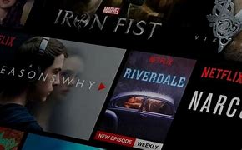
Methodology
System Architecture & Flow
Data Source: TMDB 5000 Movies Dataset.
Preprocessing:
Merge metadata → Create “tags”
Clean & stem text
Vectorize using CountVectorizer
Similarity Engine: Cosine similarity matrix (offline computed)
Frontend: Streamlit UI + TMDB API for posters
Output: Top-N similar movies with visual display

Slide 10
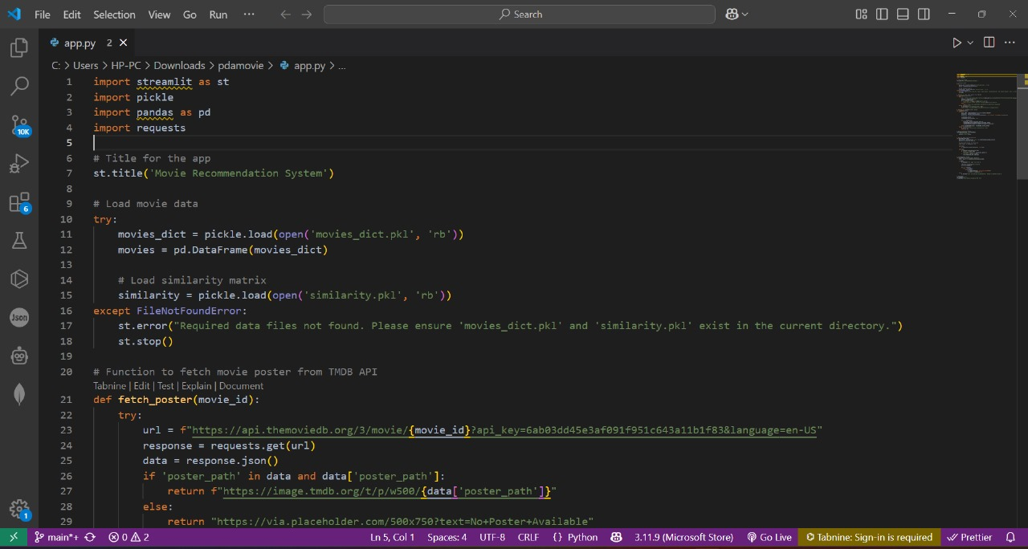
Result
Performance and User Feedback
Similarity Score (Top 5): Avg. 0.78 (strong alignment)
Response Time: ~0.4 seconds/query
User Survey (15 participants):
87% found recommendations relevant
73% praised visual design and usability
Insights: Bar charts visualize decreasing similarity values

Slide 11
.
Conclusion
Conclusion and Future Work
Developed a fast, interpretable, content-based movie recommender.
Overcomes cold-start problems and provides transparent recommendations.
Lightweight, modular design allows for future enhancements and hybrid integration.
High relevance in user feedback validates the system's utility

Slide 12
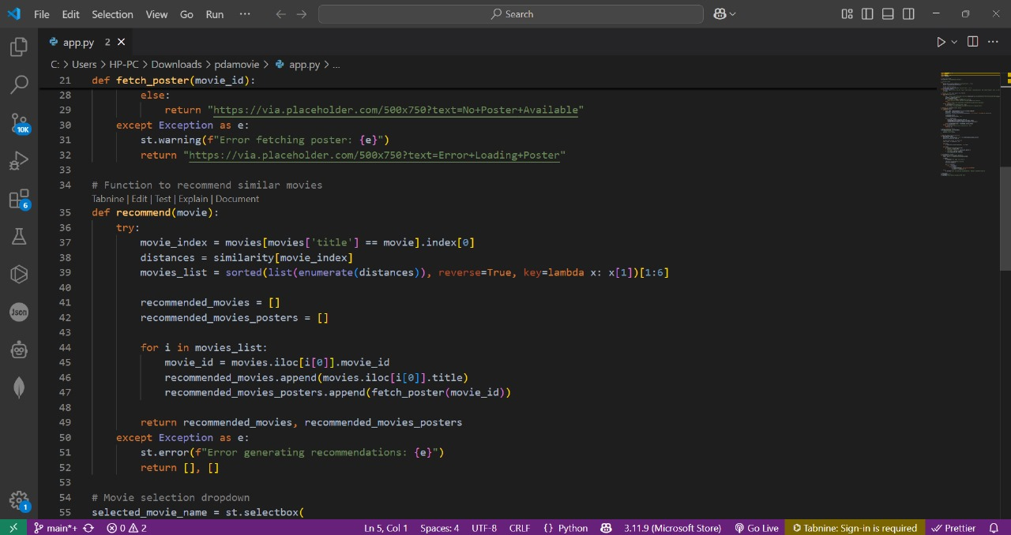
Reference
References
Burke, R. (2002). Hybrid Recommender Systems.
Van den Oord et al. (2013), Wang et al. (2019)
Ying et al. (2018). PinSage at Pinterest.
Hidasi et al. (2016). GRU4Rec.
Ekstrand et al. (2018). Fairness in Recommenders.
Zhang & Chen (2020). Explainable Recommendations.
Schnabel et al. (2016). Counterfactual Evaluation.

Slide 13
Noida institute of Engineering & Technology
Thank you

